Slide 1
An ORM tool
Used in data layer of applications
Implements JPA

Slide 2


Id
Name
Age
Brithday
id | Name | Age | birthday

Slide 3



Mapping object variables to column
Mapping relationship
Inheritance : java have , RDBMS no.
Associations :in java Reference ; in RBDMS foreign key
Handling data Type
Managing changes to object state

Slide 4
What is ORM
  ORM stands for Object-Relational Mapping (ORM) is a programming technique for converting data between relational databases and object oriented programming languages such as Java, C# etc
Advantages
  Lets business code access objects rather than DB tables.
  Hides details of SQL queries from OO logic
  No need deal with database implementation
  Entities based on business concept s rather then database structure
  Transaction management and automatic key generation
  Fast development of application

Slide 5

Enterprise JavaBeans Entity Beans
Java Data Object
Castor
TopLink
Spring DAO
Hibernate
More

Slide 6
Hibernate is an Object-Relational Mapping(ORM) solution for JAVA and it raised as an open source persistent framework created by Gavin King in 2001. It is a powerful, high performance Object-Relational Persistence and Query service for any Java Application
NHibernate for .Net. opensource

Slide 7
User Interface
UI event
Data object
Application Logic
data request
business object
business Objects
DAO
SessionFactory
Hibernate API
business object
Hibernate
hibernate.cfg.xml
JDBC API
ResultSet, etc.
*.hbm.xml class mappings
Foundation Classes
JDBC

Slide 8

<?xml version='1.0' encoding='utf-8'?>
<!DOCTYPE hibernate-configuration PUBLIC ... remainder omitted >
<hibernate-configuration>
<session-factory>
<property name="dialect">
org.hibernate.dialect.MySQLDialect </property>
<property name="connection.driver_class">
com.mysql.jdbc.Driver </property>
<property name="connection.username">student</property>
<property name="connection.password">pw</property>
<property name="connection.url">
jdbc:mysql://localhost:3306/dbtest</property>
<!-- Object-Relational mappings for classes -->
<mapping resource="eventmgr/domain/Location.hbm.xml"/>
... other mappings omitted
</session-factory>
</hibernate-configuration>

Slide 9
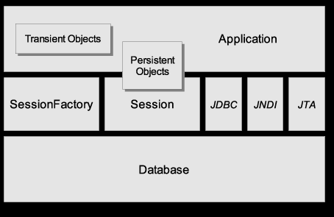
Source: Hibernate Reference Manual (online)

Slide 10
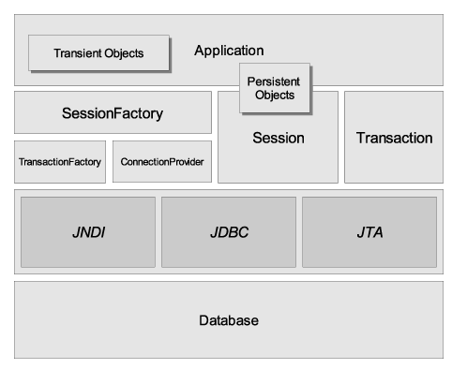
SessionFactory
A threadsafe (immutable) cache of compiled mappings for a single database.
A factory for Session.
Expensive to create.

Slide 11
Hibernate Basics
Session
A single-threaded, short-lived object representing a conversation between the application and the persistent store.
Wraps a JDBC connection.
Factory for Transaction.
Holds a mandatory (first-level) cache of persistent objects, used when navigating the object graph or looking up objects by identifier.

Slide 12
Hibernate Basics
Persistent Objects and Collections
Short-lived, single threaded objects containing persistent state and business function.
These might be ordinary JavaBeans/POJOs, the only special thing about them is that they are currently associated with (exactly one) Session.
As soon as the Session is closed, they will be detached and free to use in any application layer (e.g. directly as data transfer objects to and from presentation).

Slide 13
Hibernate Basics
Transient Objects and Collections
Instances of persistent classes that are not currently associated with a Session.
They may have been instantiated by the application and not (yet) persisted or they may have been instantiated by a closed Session.

Slide 14
Hibernate Basics
Transaction
(Optional) A single-threaded, short-lived object used by the application to specify atomic units of work.
Abstracts application from underlying JDBC, JTA or CORBA transaction.
Multiple transactions per Session.

Slide 15
Hibernate Basics
  ConnectionProvider
  (Optional) A factory for (and pool of) JDBC connections. Abstracts application from underlying Datasource or DriverManager. Not exposed to application, but can be extended/implemented by the developer.
  TransactionFactory
  (Optional) A factory for Transaction instances. Not exposed to the application, but can be extended/implemented by the developer.

Slide 16
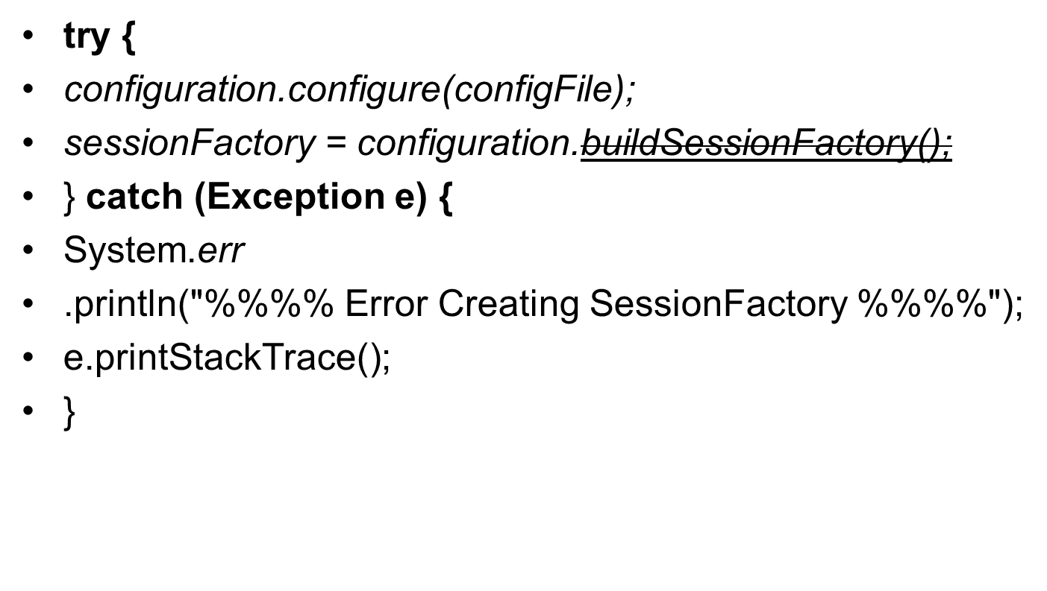

Slide 17
public Session getSession() {
return HibernateSessionFactory.getSession();
}

Slide 18
public void save(Answer answer) {
log.debug("saving Answer instance");
try {
getSession().save(answer);
log.debug("save successful");
} catch (RuntimeException re) {
log.error("save failed", re);
throw re;
}
}

Slide 19
private UserDAO uDao = new UserDAO();
……..
try {
Transaction trans= uDao.getSession().beginTransaction();
trans.begin();
uDao.save(user);
trans.commit();
} catch (RuntimeException e) {
throw e;
}

Slide 20


